Slide 1

ECO-SMART HOUSE
PROJECT PROPOSAL
Eco-Friendly Smart House for Sustainable Future

Slide 2
COMPANY PROFILE
01
PROJECT OBJECTIVES
02
03
LOCATION ANALYSIS
TABLE OF CONTENTS`
04
THE TECHNOLOGIES
05
HOUSE LAYOUT
TIMELINE
06
07
FINANCIAL PROJECTION
About PT Palapa Baru and Teams
Here you could describe the topic of the section
SWOT Analysis for Waingapu, East Nusa Tenggara..
Proposed technology for installation.
Here you could describe the topic of the section
Estimated duration for each stages.
Expected budget.
Notes:
Company Profile
Team
Objectives
Goals
Location Analysis
House Layout
Technologies (Eco-House)
Schedule → estimated time
Financial

Slide 3
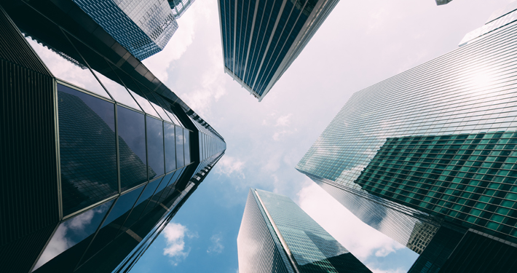
PT. Palapa Baru
PT. Palapa Baru, or PALARU, is a construction company offering home or residential construction in Indonesia. PALARU was created in 2018. Located in L’Avenue Building, Jl. Raya Pasar Minggu, Jakarta Selatan, 12780.
At PALARU, we are proud to be leaders in environmentally sustainable housing. PALARU is committed to creating homes that are not only aesthetically pleasing but also energy-efficient, with a reduced carbon footprint.
Efficient
Convenient
Modern Technology
Eco-friendly
Comfortable

Slide 4
MEET OUR TEAM
Ryufath Alief Adhyaksa Putera Soepeno
Head of Technology
Noorfi Azizah Rahim
Head of Development
Muhammad Ikhsan Effendy
Head of Finance
Nadhief Amadda Arieq
Head of Design
Oryzea Sativa Ilham
Head of Research

Slide 5
ECO-FRIENDLY SMART HOUSING SYSTEM
ADVANCE, MODERN, TECHNOLOGY
PROJECT OBJECTIVES
SUSTAINABLE MATERIALS, RENEWABLE RESOURCES
COMFORTABLE, HEALTHY LIVING ENVIRONMENT

Slide 6
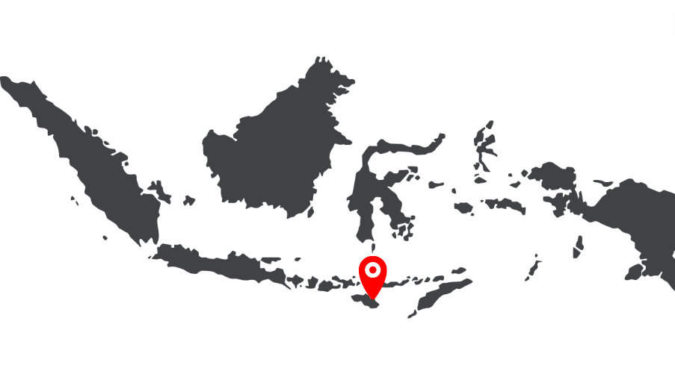
LOCATION
ANALYSIS
Kota Waingapu, Sumba Timur, Nusa Tenggara Timur, Indonesia

Slide 7
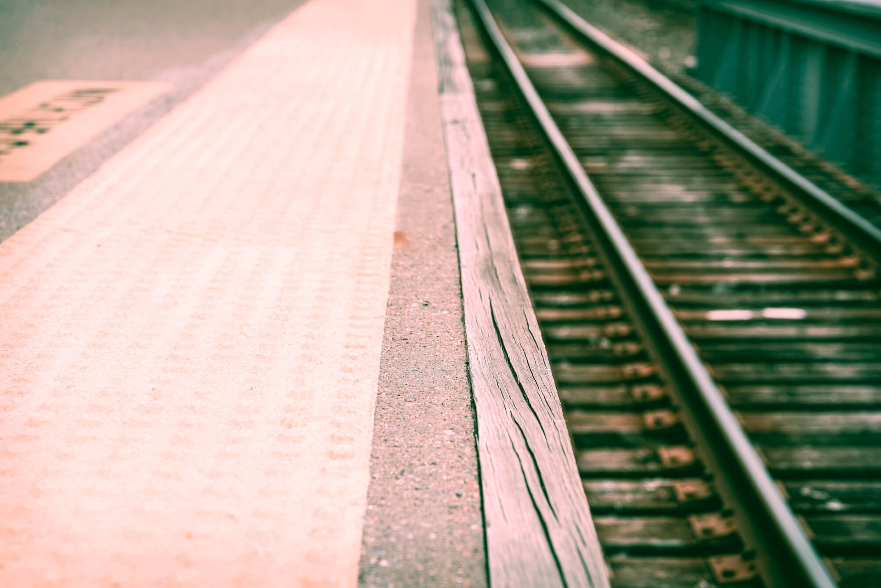
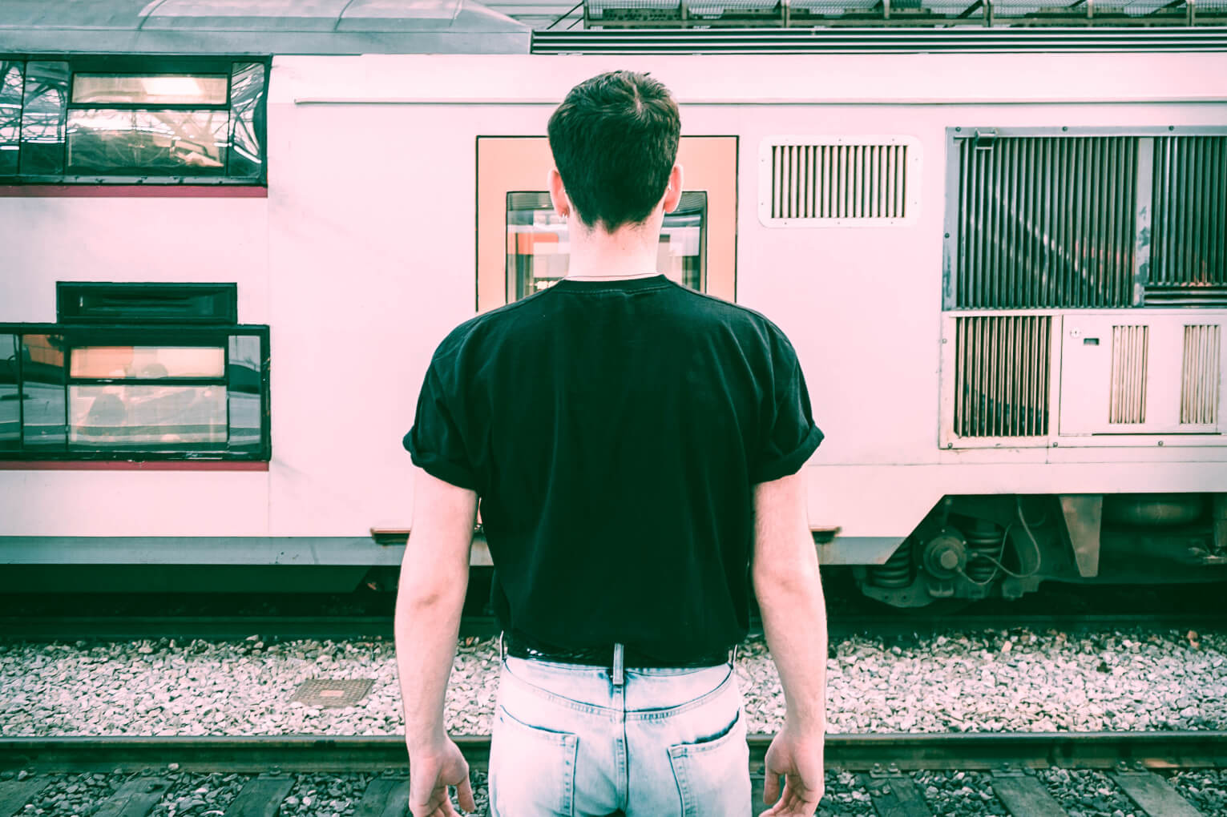
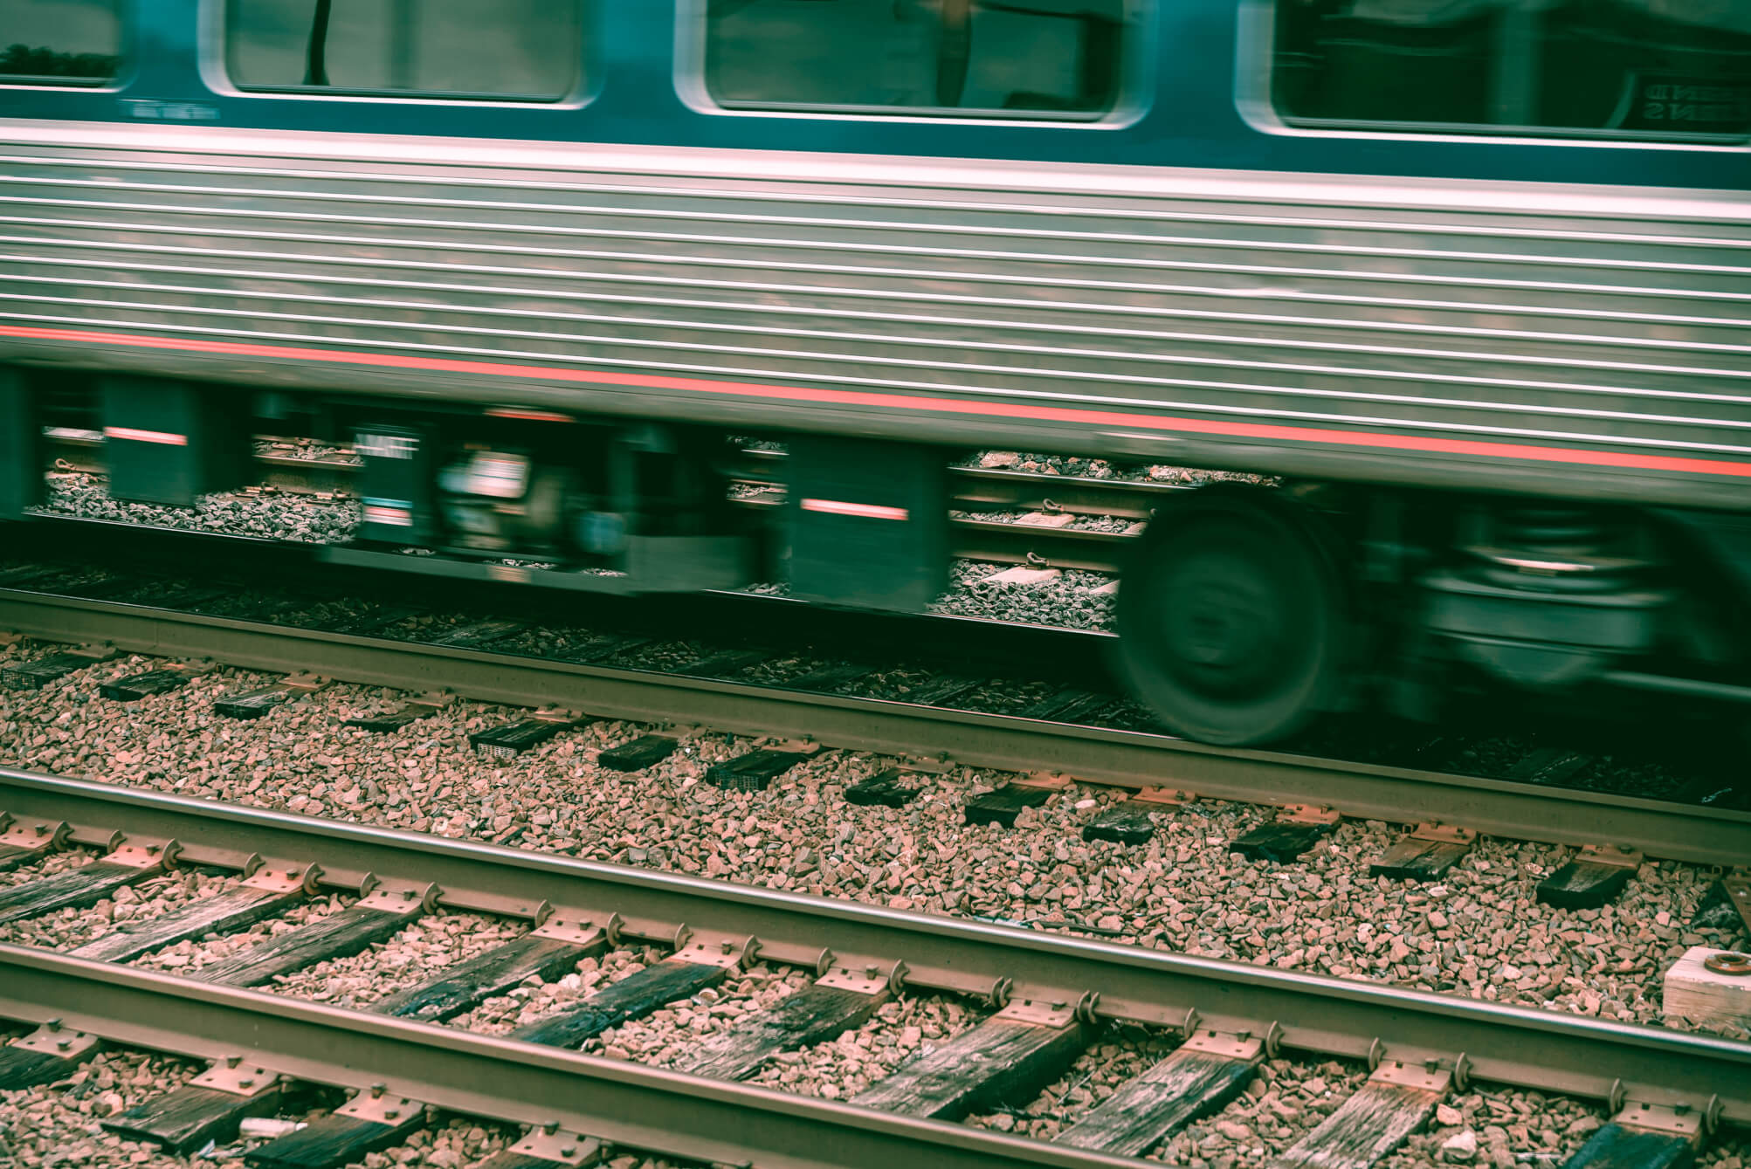
STRATEGIC LOCATION
LOCATION
ANALYSIS
LACK OF SKILLED LABOR
NATURAL DISASTERS
Well-connected transportation network, easy access to many institutions, abundant natural resources.
Lack of trained professionals, infrastructure development is limited.
High cases of earthquake and typhoon, high level humidity.
Notes:
Now, let’s look at the location analysis.

Slide 8

Smart Home

Slide 9
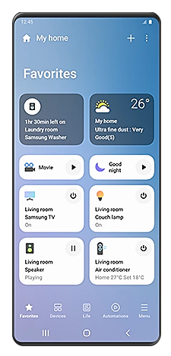
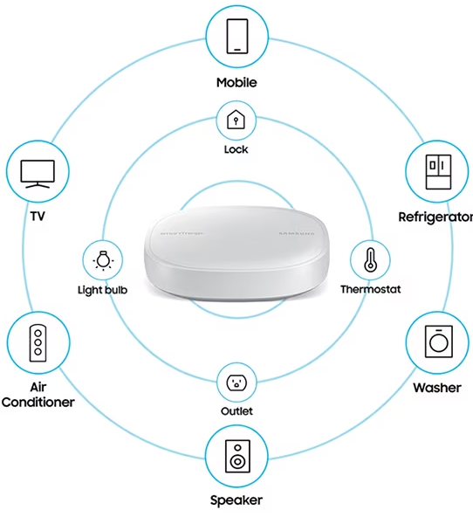
Samsung SmartThings
Control and Manage in your smartphone
Easy installation
Features:
Automation
Monitoring

Slide 10
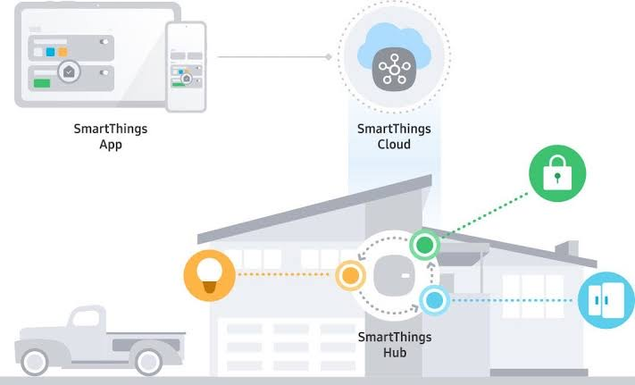

Slide 11
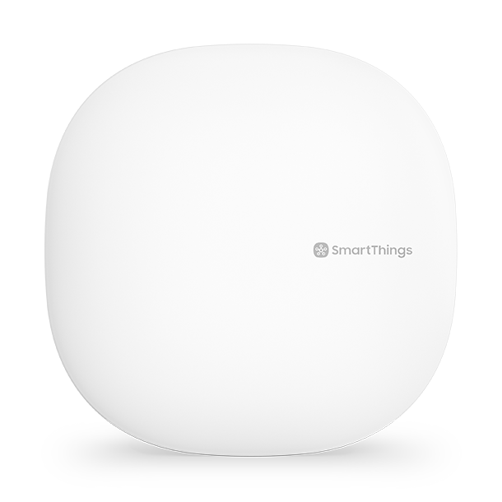
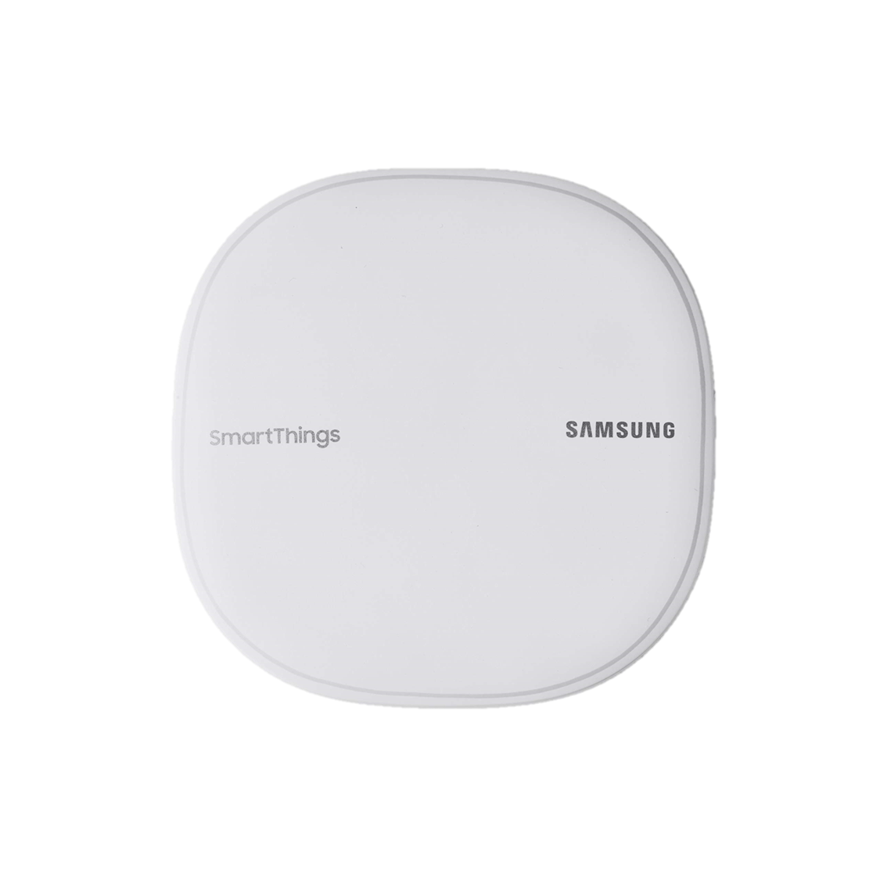
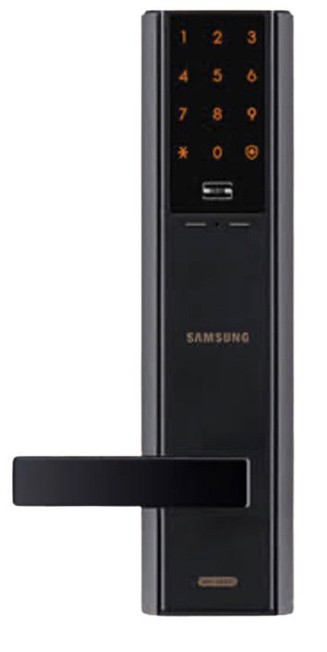
SmartThings Hub
Smart Door Lock
Smart Wi-Fi
Connect & Control all Appliances
Monitor devices
Unlock automatically With your phone
Remote unlocking
Real-time monitoring
Network Optimization

Slide 12
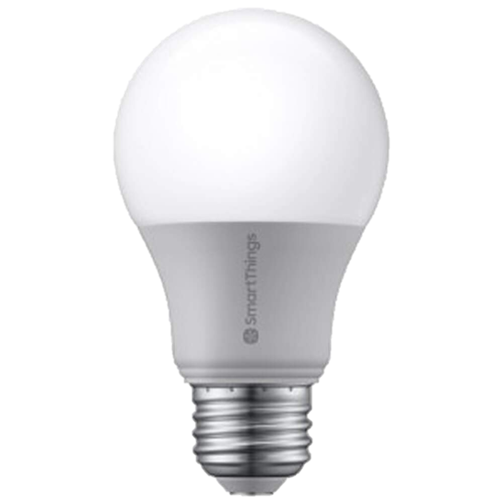
Smart Bulb
Low energy
Automated with SmartThings
Voice Commands

Slide 13

Eco-Friendly Features

Slide 14
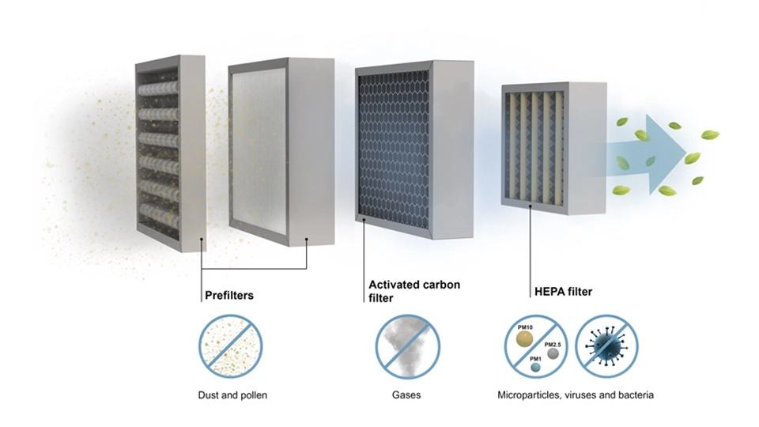
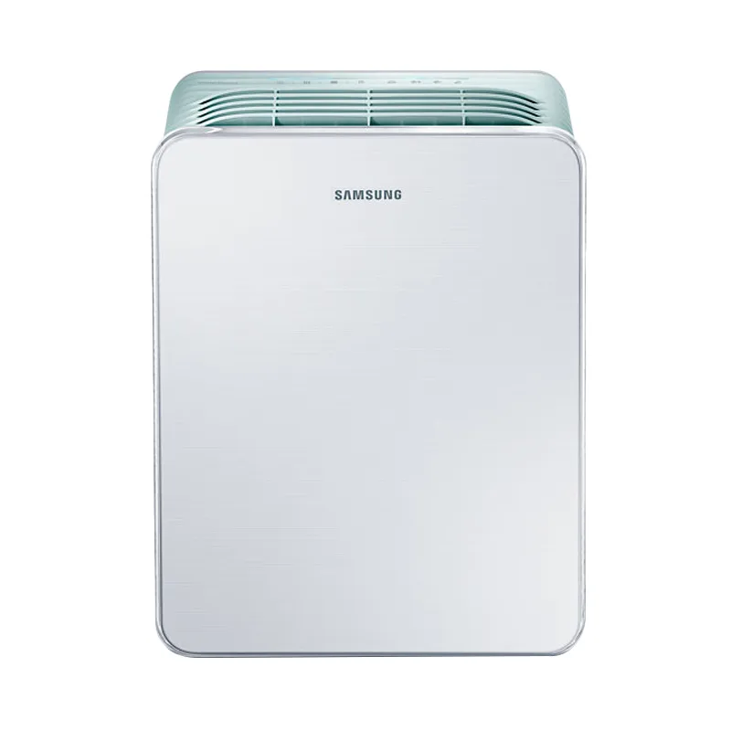
Samsung High-Efficiency Particulate Air (HEPA) Filter
Samsung HEPA Filter

Slide 15
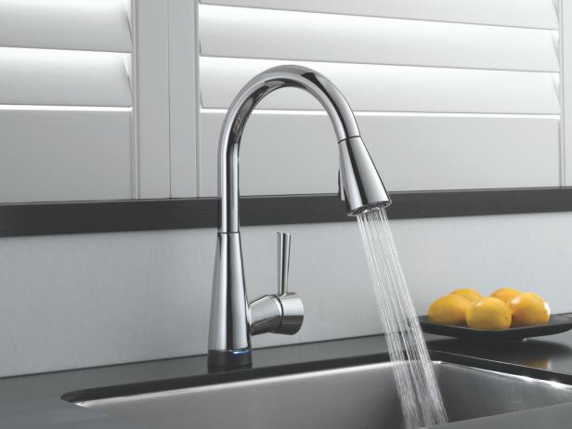
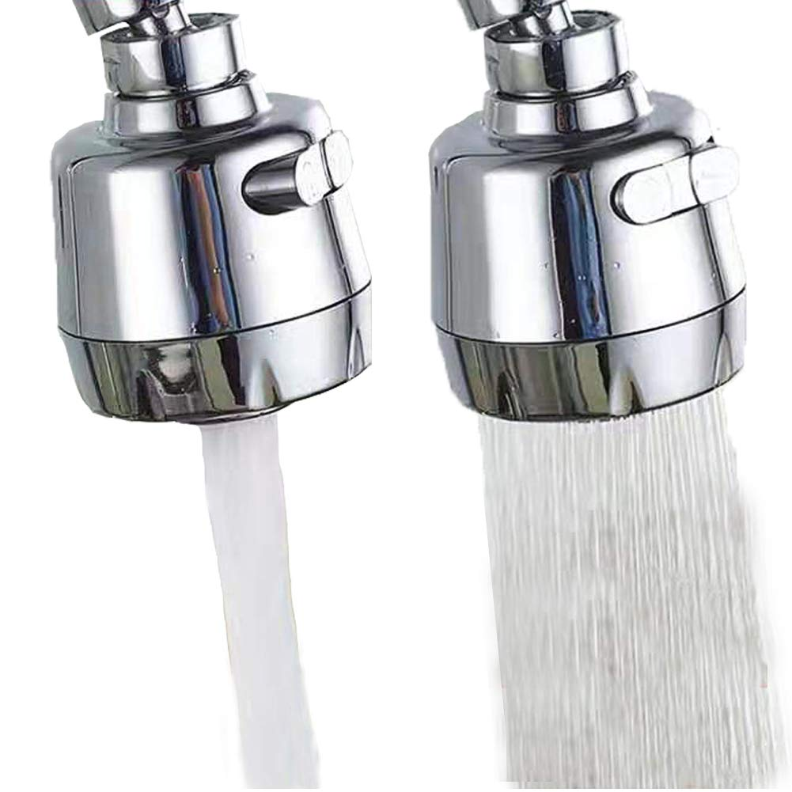
Water Fixtures
Rotary knobs
(Aerator or Low-flow)

Slide 16
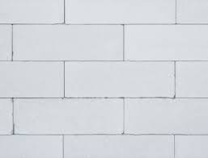
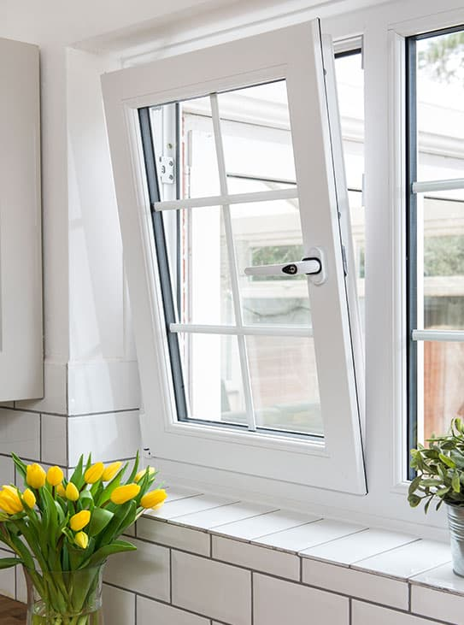
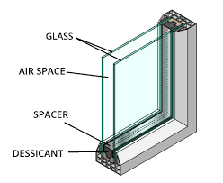
Noise Management System
Double-Pane windows
Cellular Concrete Bricks
Double-Glazed Windows

Slide 17
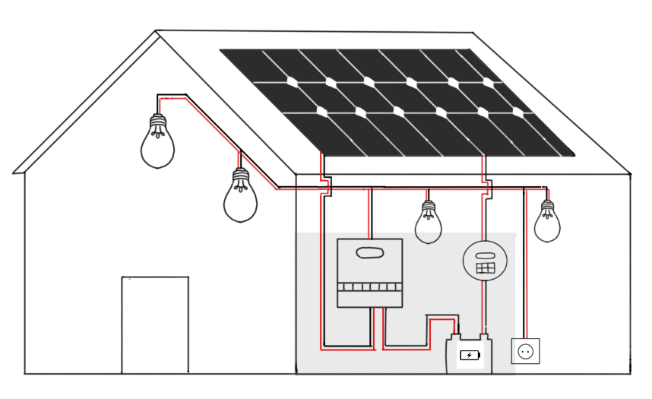
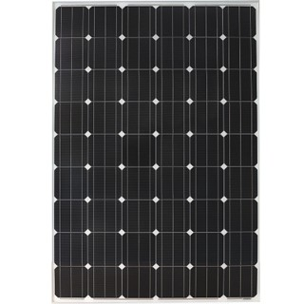
Off-Grid Monocrystalline Solar Panel
Without Solar Panel::
-Rp.60.000/Month -> 100kWA/Month
With Solar Panel:
-Rp.60.000/Month -> 280kWA/Month
*PDAM Tarif in NTT is Rp.600/kWA
Solar Panel
Multi-Output Inverter
Controller
Battery Storage
Monocrystalline Solar Panel

Slide 18
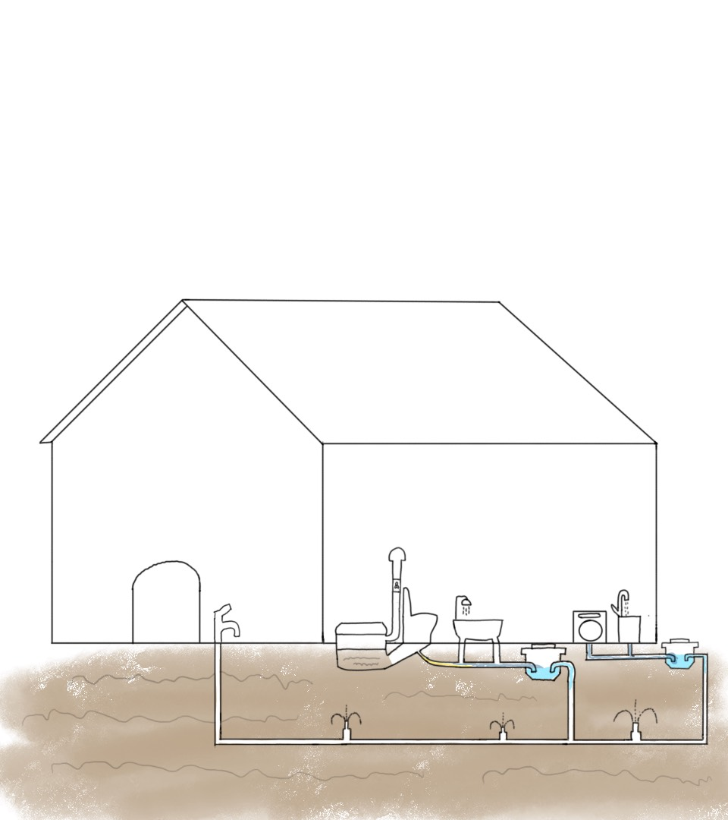
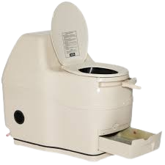
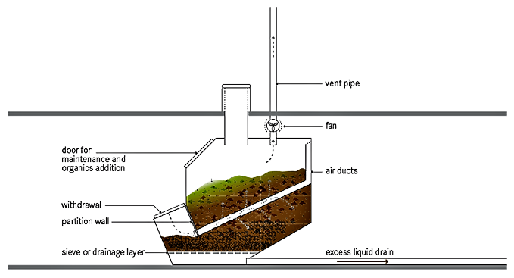

Waste Management System
Exterior Without Management System:
-20M3/Month -> Rp.99000/month
Exterior With Waste Management System:
-12M3/Month -> Rp.59400/month
*PDAM Tarif in NTT is Rp.4950/M3
PVC Vent Pipe
Composting Bin
Blackwater Septic Tank
Greywater Septic Tank
Composting Chamber
Hose
Sprinklers

Slide 19
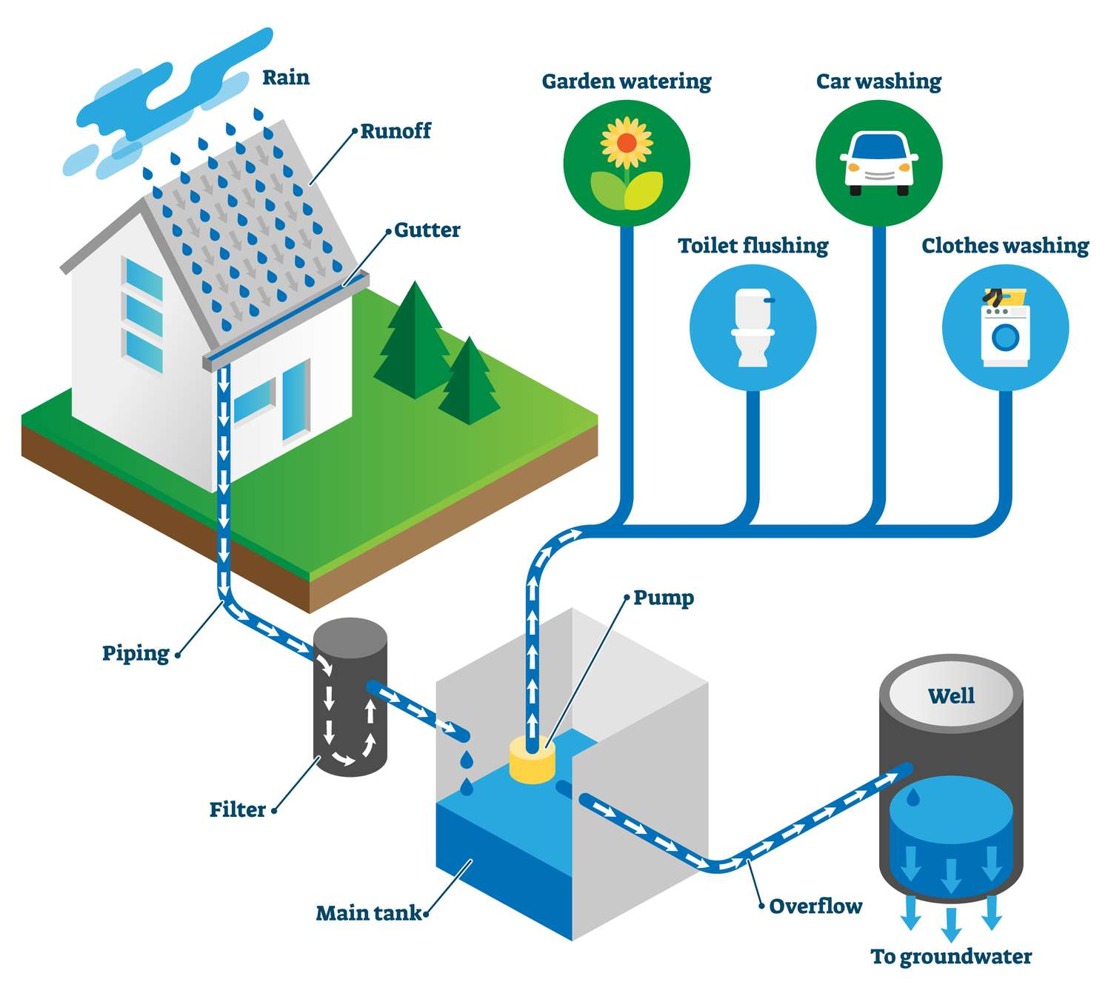
Rainwater Harvesting System
Without Harvesting System:
-20M3/Month -> Rp.99000/month
With Harvesting System:
-20M3/Month + 8M3/Month -> Rp.99000/month
*PDAM Tarif in NTT is Rp.4950/M3

Slide 20
Monthly Cost-Benefits
 | Normal : Eco-friendly | Amount Saved
Electricity Output | 100 : 280 kWA | 35%
Water Spent on Garden | 20 : 12 M3 | 60%
Water Output | 20 : (20+8) M3 | 71%
Overall |  | 56%

Slide 21
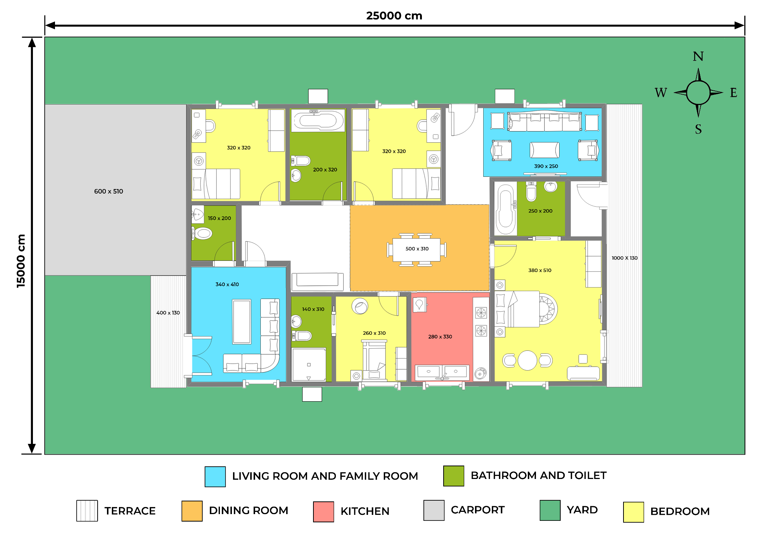
FLOOR PLAN

Slide 22
TIMELINE
266
Days
Jul - Sep
Nov - Jan
Structural Work
Plumbing and Electricity Installation
Jun - Jul
Sep - Nov
Jan - Feb
Administrative Work
Windows, Doors, Roof and Floor Installation
Painting, Technology Installation and Finishing

Slide 23
Rp9.774.700
ADMINISTRATIVE
Rp95,296,750
LABOR COST
Rp591,690,400
BUILDING MATERIAL
FINANCIAL PROJECTION
Rp24,149,000
SMART TECHNOLOGIES
Rp128,137,440
ECO-FRIENDLY TECHNOLOGIES
TOTAL : Rp849,048,290

Slide 24
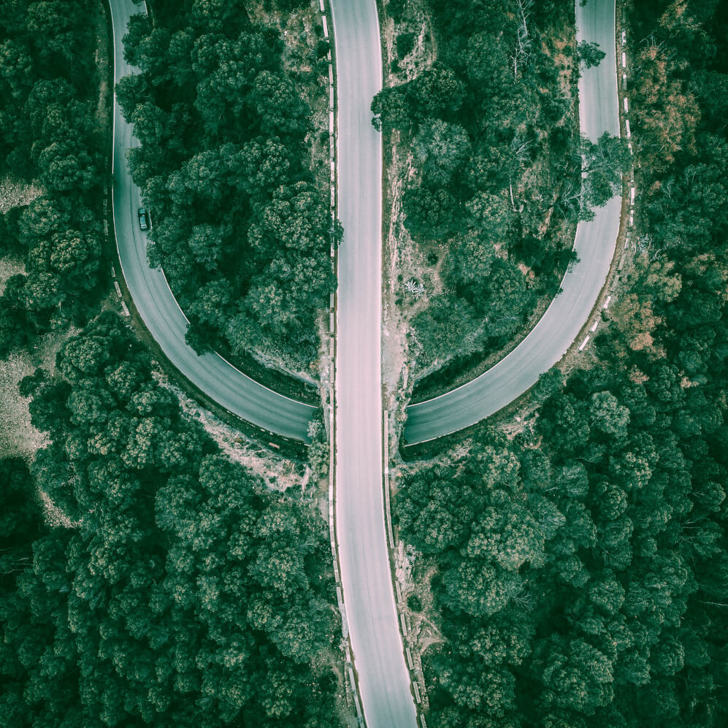
CONTACT US
Does anyone have any questions?
nadhief@palaru.com
+62 81 231 667 891
palaru.com

Slide 25


